Slide 1

Capstone Project
Play Store App Review Analysis
Presented By
SUMIT KUMAR
Data Science Trainee, AlmaBetter

Slide 2


❑ Introduction ❑ why analyze the google play app store? ❑ Problem Statement ❑ Category wise play store apps installs ❑ Category wise most popular apps ❑ Top 10 apps in play store considering all the parameters ❑ Average installs, category wise ❑ Most installed apps in communication category ❑ Average sizes of apps in each category ❑ Category wise percentage of paid apps ❑ Category wise top installed paid apps ❑ Average rating of paid apps ❑ Correlation between Rating ,Installs and Price
Agenda

Slide 3


WHY ANALYZE THE GOOGLE PLAY STORE APP?
Google Play Store is an online App store like Games, Movies, Books etc. where people can find their favorite Apps. And it provides more than 10 million Apps and Games to billions of people over the world and it’s generating more than 120$ billion earning to developers.
The main objective of the Project is that to understand the Users demand what they expecting from using their apps and thus it helps to update and develop the product by Developers.

Slide 4
Introduction
• In today's day-to-day scenario, we can see that mobile apps play an important role in
any individual’s life. With enormous challenges from everywhere throughout the globe,
a designer needs to realize whether he/she is continuing in the right direction or not. To
hold this income and their place in the market the application designers may need to
figure out how to stick to their present position.
• The dataset with 10k Play Store applications is available to analyze the Android market. It can be examined to analyze the different categories, such as family, communication, entertainment, tools, music, camera, etc. In this project, we examine the different attributes present in the data set that affect the popularity of the application. We focused on answering questions like, "What makes an app popular? ", "What should be the price and size of the app, and "Are there some trends in user sentiment?" In our data set, we have two CSV files for data analysis

Slide 5
Problem Statement
❏ Two datasets are provided, one with basic information and the other with user
reviews for the respective app.
❏ We must examine and evaluate the data in both datasets in order to identify the
important characteristics that influence app engagement and success.
Play Store needs to focus more on ⬇
1. Focusing more on content available for everyone will increase the chances of
getting the highest installs.
2. Most of the apps are free, so focusing on free apps is more important.
3. Developing apps related to the least categories as they are not explored much.
like events and beauty.
4. They need to keep in mind that the sentiments of the user keep varying as they
keep using the app, so they should focus more on the user's needs and features.

Slide 6

Dataset Preparation
▪ Loading the data sets: There are two datasets, the First Play
Store app dataset and the User Reviews dataset.
▪ Import Libraries: NumPy, Pandas, Seaborn, and Matplotlib
▪ Data cleaning: Null values, finding and removing outliers, and
removing duplicate data.
▪ Data imputation: filling the missing categorical values with the
mode and the missing numerical values with the median.
Conversion of price, installs, and reviews into numerical values.
▪ Exploratory Data Analysis: Analysing the data sets to summarize
their main characteristics using statistical graphics and data
visualization methods

Slide 7
Attributes in Google Play store Data
APP : This column contains the name of the app for each observation.
CATEGORY : This column contains category to which the app belongs.
RATING : This column contains the average rating for the app.
REVIEWS : This column contains the number of reviews that the app has received on the play store.
SIZE : This column contains the amount of memory the app occupies on the device.
INSTALLS : This column contains the number of times that the app has been downloaded and installed from the play store.
TYPE : This column contains the information whether the app is free or paid

Slide 8
8. PRICE: If the app is a paid app, this column contains the data about its price.
9. CONTENT RATING: This column contains the maturity rating of the app i.e. the
age group of the audience for which it is suitable.
10. GENRES: This column contains the data about to which genre the app belongs.
genres can be considered as a further division of the group of category.
11. LAST UPDATED: Contains the date on which the latest update of the app was
released.
12. CURRENT VERSION: Contains information on the current version of the app
available on the play store.
13. ANDROID VERSION: Contains information about the android versions on which
the android version is supported.

Slide 9
Attributes in User reviews
App- Application name
2. Translated Review- User review
3. Sentiment- Positive/Negative/Neutral
4. Sentiment Polarity- Sentiment polarity score
5. Sentiment Subjectivity- Sentiment subjectivity score

Slide 10


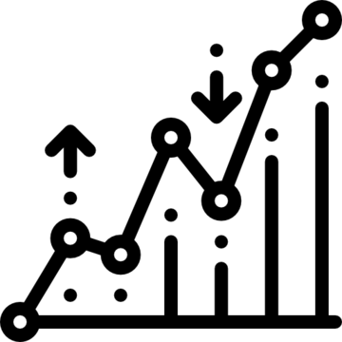
Overview of Analysis
Data Cleaning
Data Exploration
Predictive Modeling
Understand the
structure of the
dataset and clean
data before analysis
Formulate a statistical
model to forecast
an outcome
using relevant
predictors
Uncover initial patterns,
characteristics, and points
of interest using visual
exploration

Slide 11
Handling the NaN Values
Missing Data can occur when no information is provided for one or more items or for a whole unit. Missing Data is a very big problem in a real-life scenarios. Missing Data can also refer to as NA(Not Available) or NaN(Not a Number) values in pandas. In DataFrame sometimes many datasets simply arrive with missing data, either because it exists and was not collected or it never existed.
Columns which we have handles the NaN Values :-
● The Rating column has 1474 NaN values.
● The Type column has 1 NaN value.
● The current Var column contains 8 NaN values.
● The Android Var Column contains 2 NaN values.
Above, we handled all the NaN values in a particular column.

Slide 12
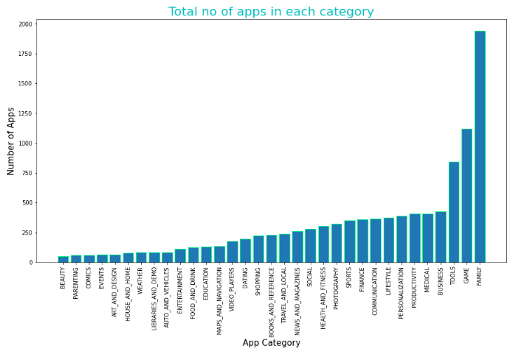
Share in the PlayStore App Category wise
From the Plot we can see that Play
store has almost 33 categories.
In this plot topmost apps share are
from Family and Games and least
are from Comics and Beauty.

Slide 13
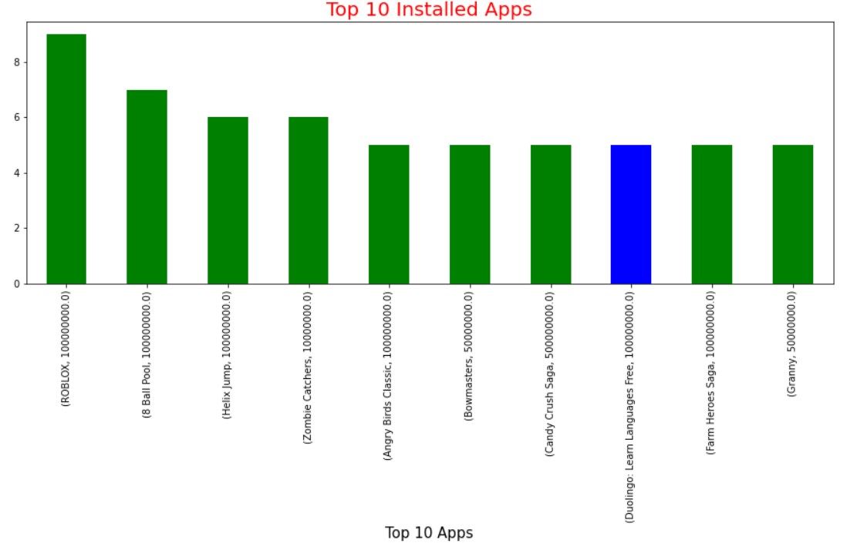
Top 10 Installed Apps from Play store
As we can see from the diagram that the most Installed Apps from Play store are in the Games Category like Roblox, 8 Ball Pool, Zombie Catchers etc.

Slide 14
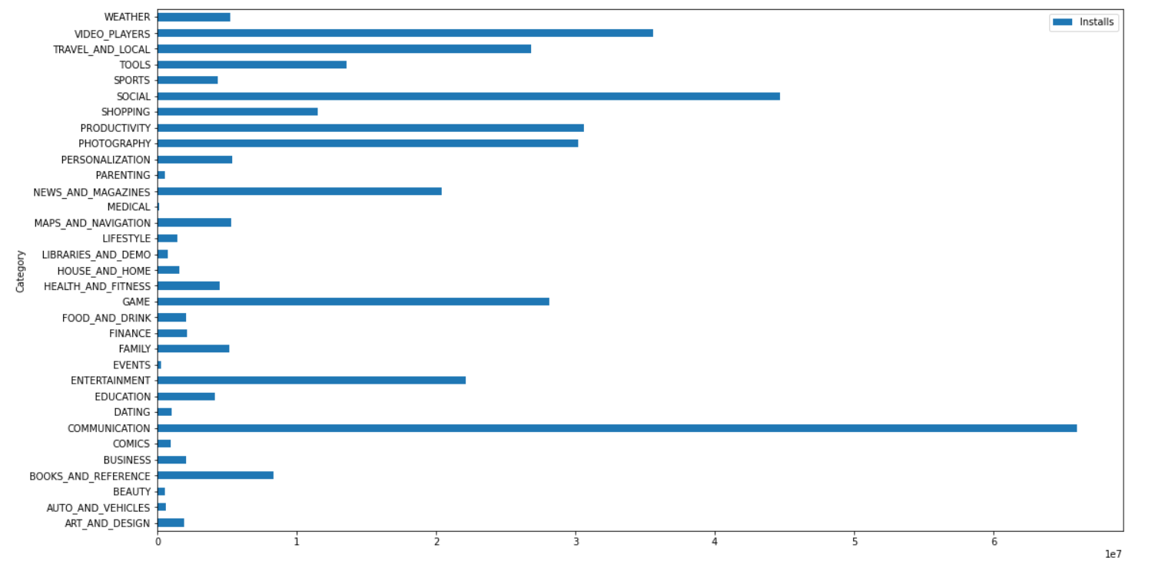
Average Installs of app category wise
From the diagram we can see that the average Installs Apps from Play store are in the Category of Communication, Social and Video Players

Slide 15
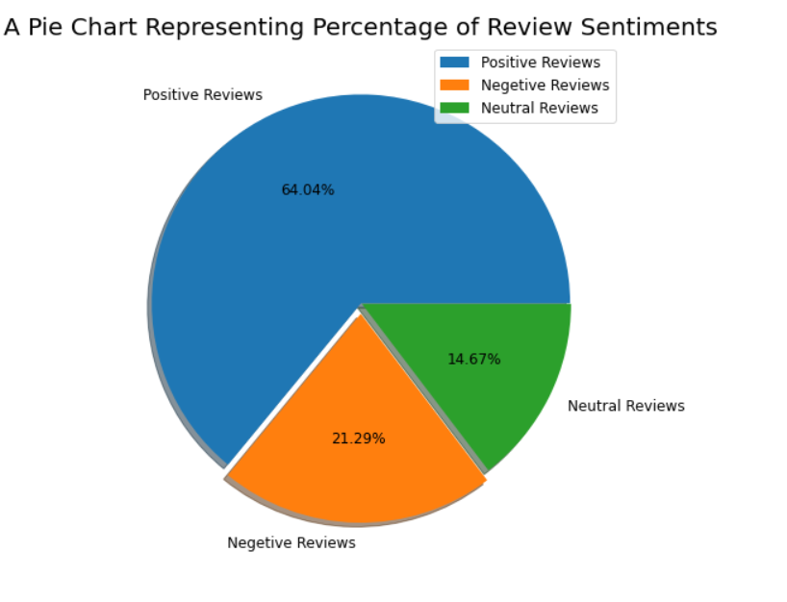
What is the Percentage of Review Sentiments
From the Pie-Chart we can see that there are in total 64.04% Positive reviews, 21.29% are negative reviews and 14.67% are neutral reviews. From the Pie- Chart we can conclude that the positive reviews are highest.

Slide 16
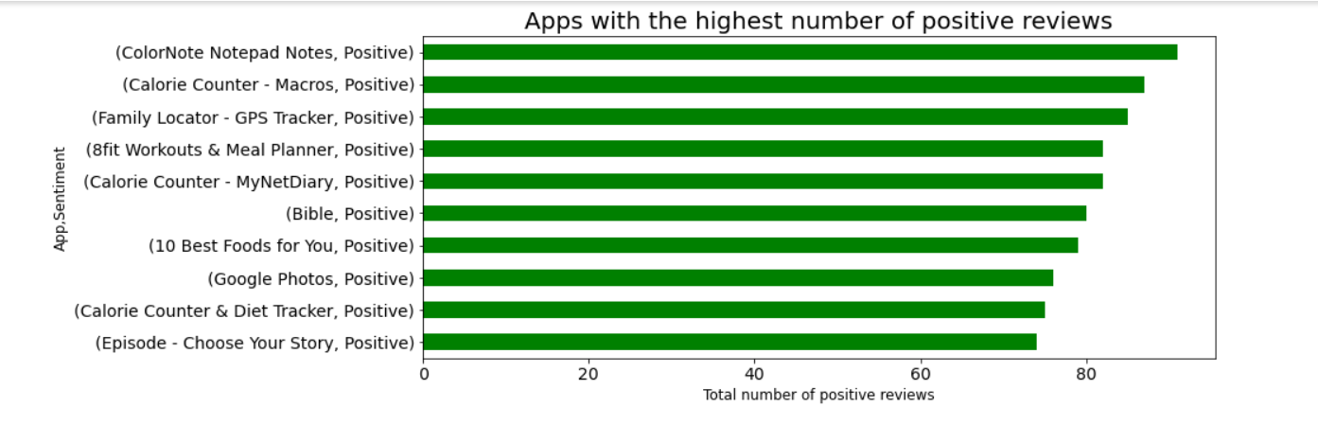
The Top 10 Positive Review Apps
As the diagram shows that the most Positive Review Apps are ColorNote Notepad Notes, Calorie Counter, Family Locator.

Slide 17
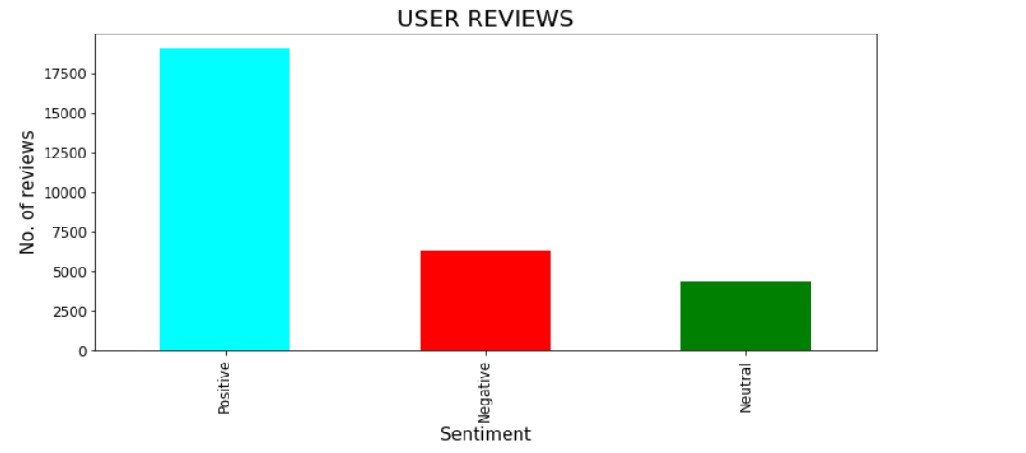
Types of reviews given by users in playstore
From the graph we can see that the values of each content ratings and also we can say that playstore has more number of positive ratings of 64% with 17500+ reviews given by the users and has only 21% negative ratings in playstore.
64%
21%
15%

Slide 18
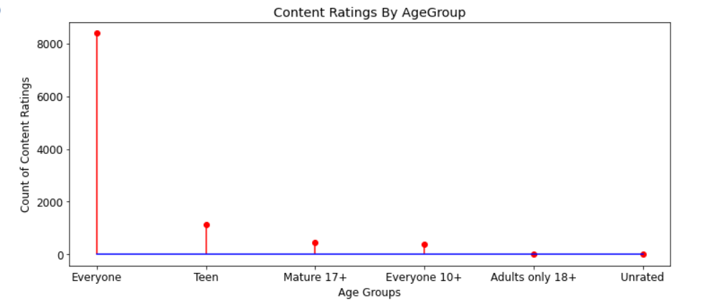
Content Ratings of Age Groups
we can clearly see from the diagram that content ratings of age group of “everyone” is highest in the playstore with 8000+ ratings and the ratings given by age group “Adults only 18+” is least with only 3 ratings in the playstore.

Slide 19
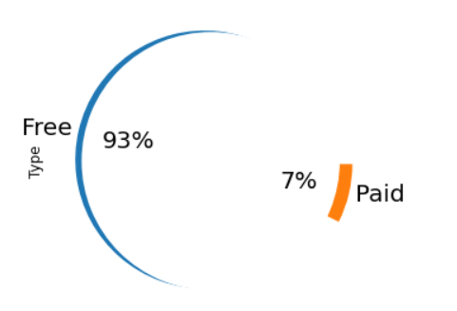
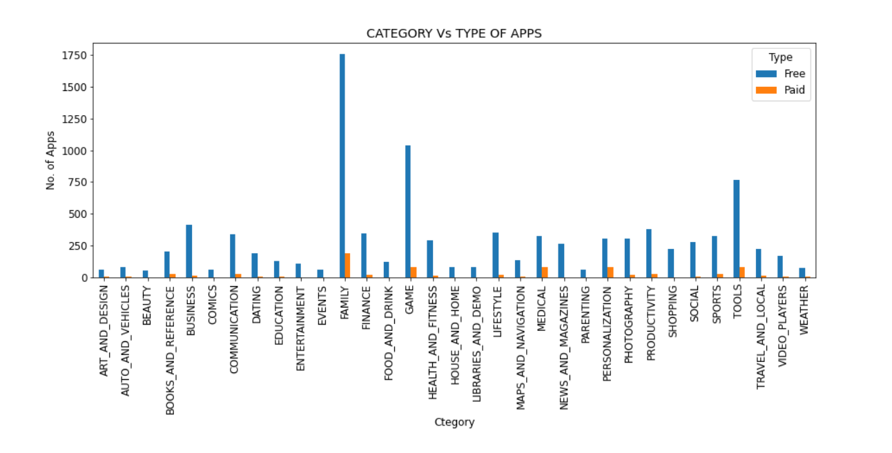
How much of the app is free and how much is paid?
In the mentioned graphs we can see that there are various type of apps which are paid and free and from the Pie chart its clear that playstore consists of most number of free apps with 93% and paid apps with just 7%

Slide 20
Thank You

